Slide 1

M.Sc.(Cs)-1 Sem-1 2021-2022 WEB 3.0
BY
A20 MANISH PAWAR
A18 KARAN THORAT
A21 MANOJ HOJI
A02 ADITYA BHAGAT
A22 Nikhil BORSE

Slide 2
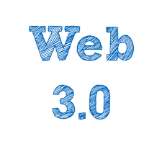
DEFINAITION OF WEB 3.0
The creation of high-quality content and services produced by gifted individuals using web 2.0 technology as an enabling platform.
Highly specialized information silos , moderated by a cult of personality, validated by the community, and put into context with the inclusion of meta-data through widgets.
Web 3.0 will be “application that are pieced together”- with the characteristics that the apps are relatively small, the data is in the cloud, the apps can run on any device(pc or mobile), the apps are very fast very customizable, and are distributed virally (social network, e-mail, etc).

Slide 3
CHARACTERISTICS OF WEB 3.0
Validated by the community
Use of widgets
Personalized interaction
Intelligent search
Behavioral advertising
Understanding of semantics

Slide 4
Characteristic Change
Web 3.0 will transform the Internet into a massive, universally searchable database and our place in it will be to organize this wealth of information into slices that are understandable to us
One of the main organizational tools that we will use are widgets and a host of data management technologies.

Slide 5

Cloud Computing
Users will be able to access documents from any device (smart phones, laptops, desktops, tablets) as long as they are connected to the internet using sites like MobileMe from Apple and Drobox.
This technology will make carrying around a flash drive and emailing documents to oneself a thing of the past.

Slide 6
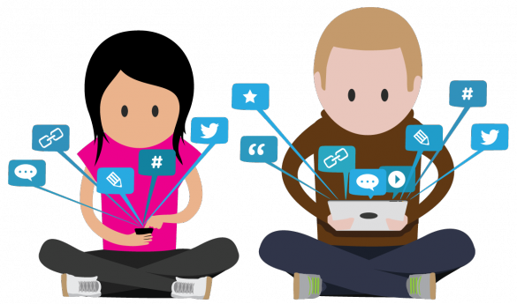
MICRO-BLOGGING
Microblogging will be the critical in the way we write in web 3.0
Imagine a world where your cell phone, your email, and your television could all produce feedback that could easily be pushed to any or all blogging platform for your “friends” or “followers” to see.

Slide 7
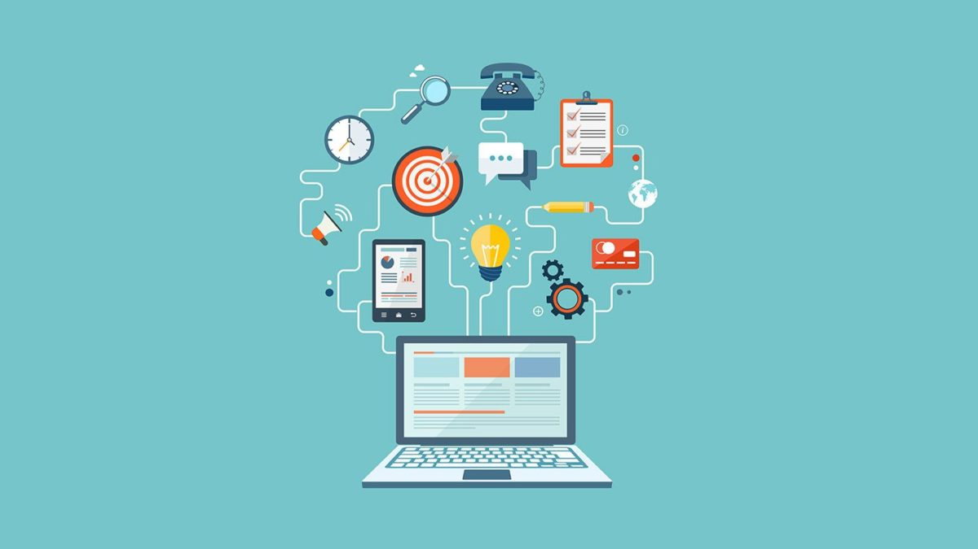
MOBILE TECHNOLOGY
Cell phones
Video Game Consoles
Smart Watches
Pedometers
If it produces data, it s likely that there will be a method to upload that data . If data can be uploaded into a universal format(such as RSS) it will be able to be “pushed” into whichever receptacle you deem appropriate.

Slide 8
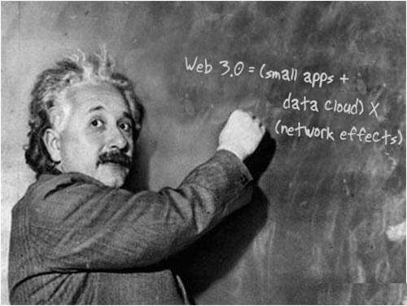
SEMANTICS
The meaning of data which will be understood by Web 3.0, unlike Web 1.0 and 2.0 which only interpreted syntax (how the data is presented or read).
Web 1.0 lacked context, Web 2.0 lacked interoperability, Web 3.0 will be a web where websites become web services and access to any information you desire is no more difficult than installing a widget onto your website.
The 3D design is being used widely in websites and services in web 3.0. Museum guides, computer games, e- commerce, geospatial contexts, etc. are all examples that use 3D graphics.

Slide 9

Semantic web Architecture

Slide 10
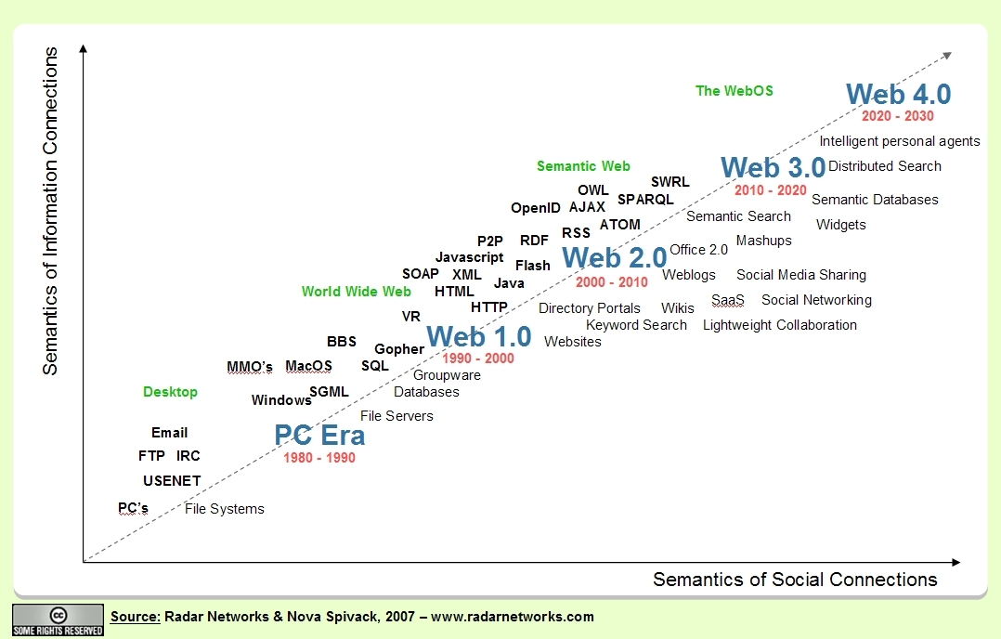
Comparison of web generations

Slide 11
Advantages of web 3.0
Semantic web will help in the network of online information.
Proficient looking
Better showcasing
More productive web perusing
Compelling correspondence.
Change human collaboration

Slide 12
Disadvantages of web 3.0
Less progressed gadgets won’t have the option to deal with web 3.0.
Technology isn't altogether prepared for it yet.
Easy to get user’s public/private information.
People will spend more time surfing the web.

Slide 13
Conclusion
Web 3.0, aiming at making the internet a better, smarter network, is a precursor to the fully semantic web, and successor to the web 2.0.
The evolution from web 2.0 to web 3.0 will be based on the adaptation of solution geared towards meeting the demands of the end user.

Slide 14
THANK YOU

